Slide 1
Evanston Food Resources Chatbot
Author: Mengyang(Doris) Cao

Slide 2
Information Transparency in Food Insecurity
Information transparency is vital to accessing available food resources for people who need help and increasing participation of the public in food insecurity issue.
This chatbot tool being developed may potentially help with the current situation in the following ways:
people in need may use it to match with the food resources best serve their demands
food providers may utilize it to connect with each other for food sharing or other possible assistance
people who are willing to donate or volunteer may use the chatbot to contact food providers

Slide 3
Data
All data being used for this chatbot is collected from food providers with the help of City of Evanston.
Data set contains information on:
food providers’ contact information
location
connection among food providers
target population
0pening time/frequency
category of food provided
whether provide delivery
whether accept SNAP
whether accept donation or volunteer work

Slide 4
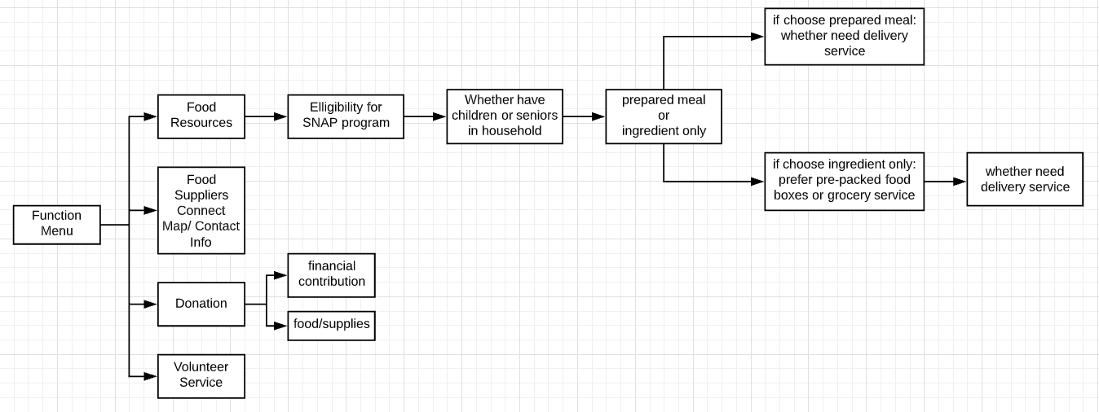
Design
Design of this chatbot follows a decision tree structure

